Slide 1
On Three Photography
Case study by Brian Nguyen

Slide 2
The problem
Company
Context
Problem statement
On Three Photography is a lifestyle and event photography business owned by Stephen Ong and Kegham Hovsepian.
The company feels the design of the site is outdated. They would like a full redesign while still keeping their core content and message intact.
Provide an outline of design issues to be improved upon with reasoning and solution. Deliver a working prototype of the home page.

Slide 3
Challenges deep-dive
Highlighting issues
Matching the brand
Prototyping
The starting point
Comb through the website and note any glaring design flaws. Layout choices, font sizing, alignment issues, etc.
Design and perception
Color scheme: Light or dark, choosing a palette (60/30/10), color psychology.
Font: Serif or sans-serif? Multiple fonts?
Creating a deliverable
Complete a Figma wireframe.
Plan code structure.
Deliver a static prototype site.

Slide 4

Design Flaws
The issues to be addressed

Slide 5
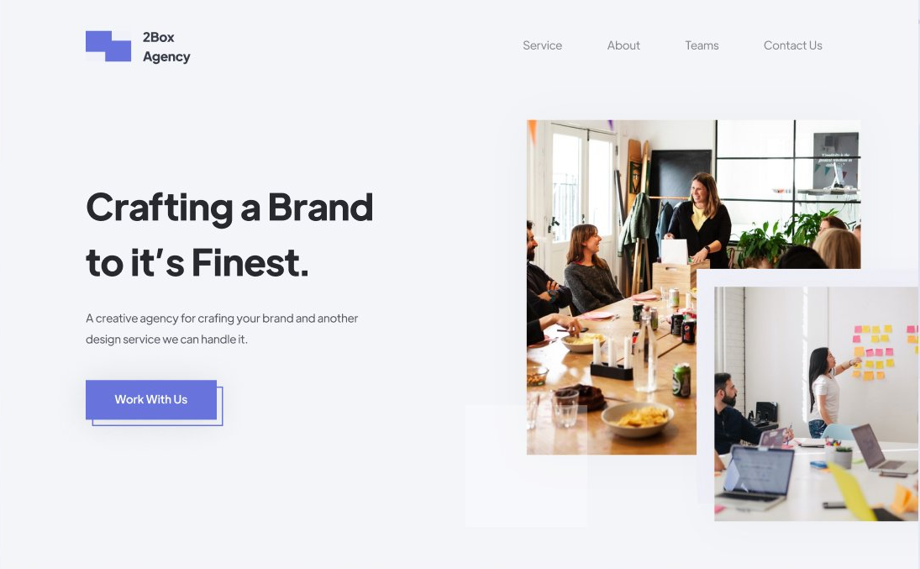
Hero Section
The most influential part of a website - most viewers will leave if a hero section is not to their liking.
Should show the business’ brand and identity at a glance.
The typical layout
Image: One large image or many small images
Header: Basic description of brand
Subheader(?)
Call to action

Slide 6
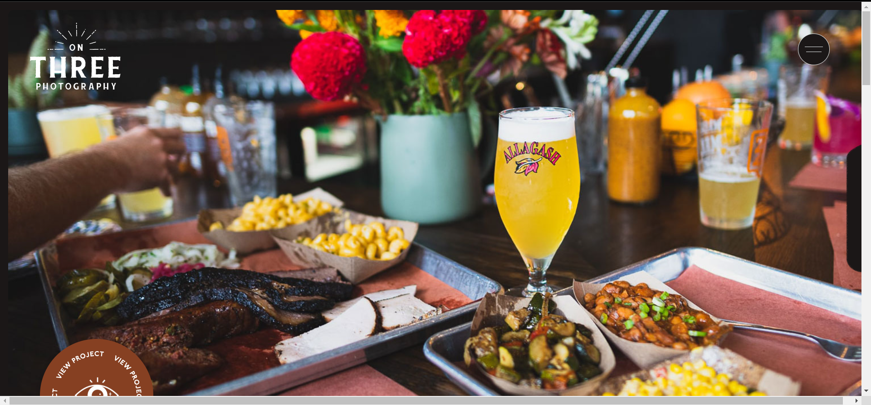
Image padding inconsistent, should factor out scroll-bar
Small, high-contrast borders produce a stair-step effect
Unclear message. Is this a barbeque company? Work images should be limited to the work section.
Lack of header and call to action.
No incentive to scroll
Horizontal scrolling not needed; padding and margin issues.

Slide 7
Work Page

Slide 8
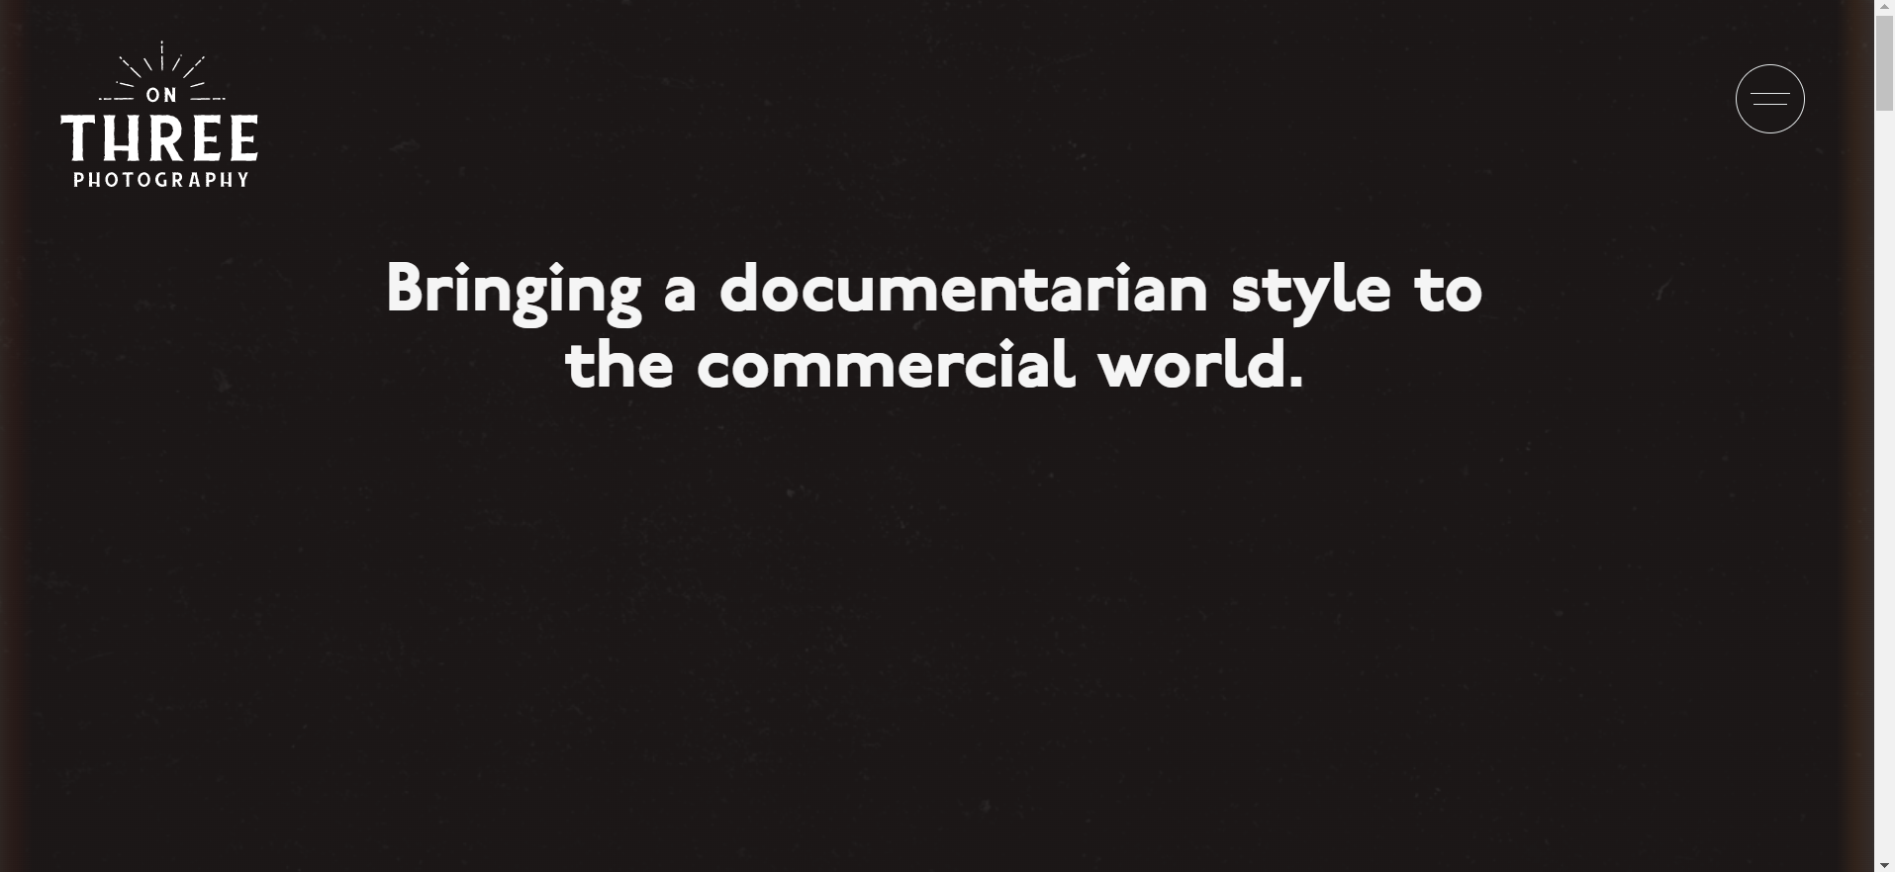
No indication this is the work page; header needed
This could be a subheader
Images do not appear until after scrolling. Viewer sees black screen on load.

Slide 9
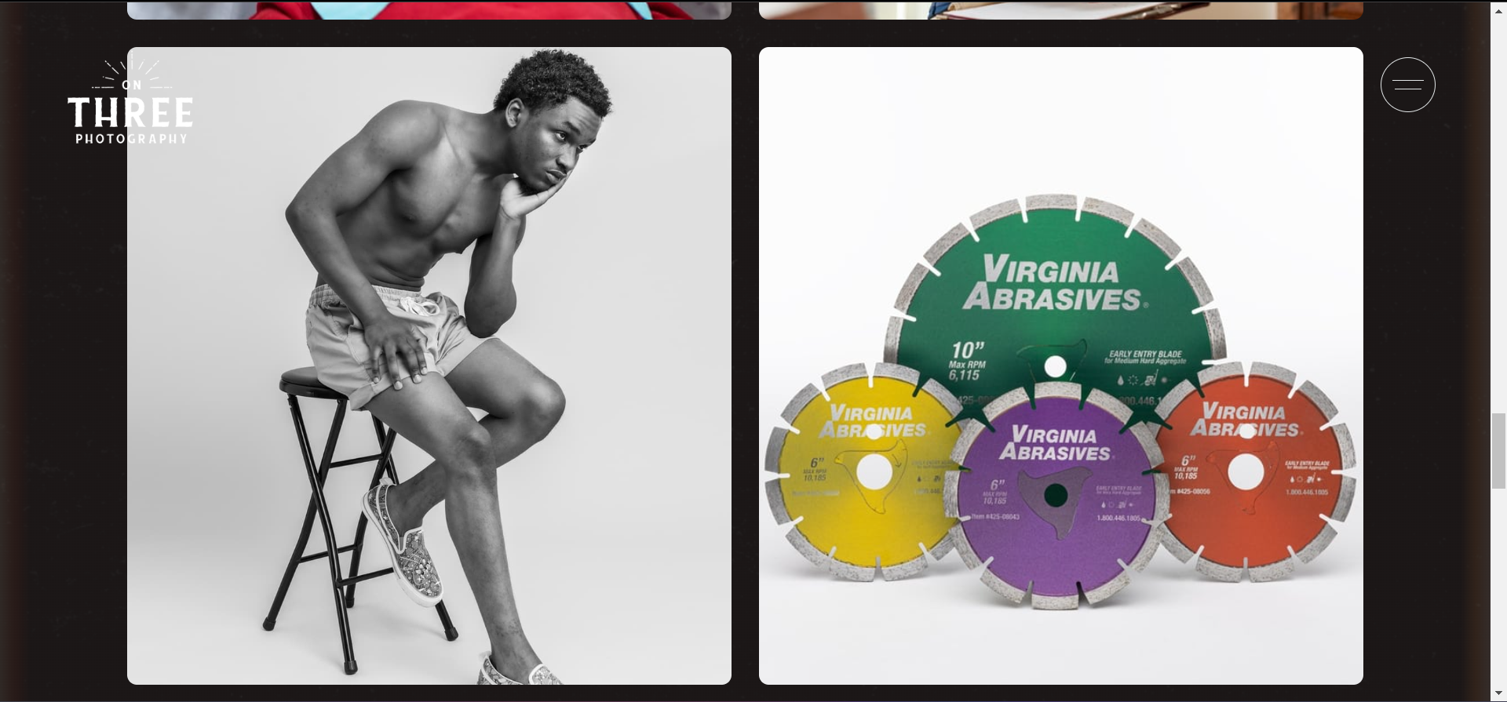
Grid-layout overbearing for viewers, lack of focus
Switch to simple sections or a selection menu?
Lack of cohesion between different images, breaks theme of website.
Little interactivity; not very fun to browse.
Photoshoot header/description is only visible on hover

Slide 10
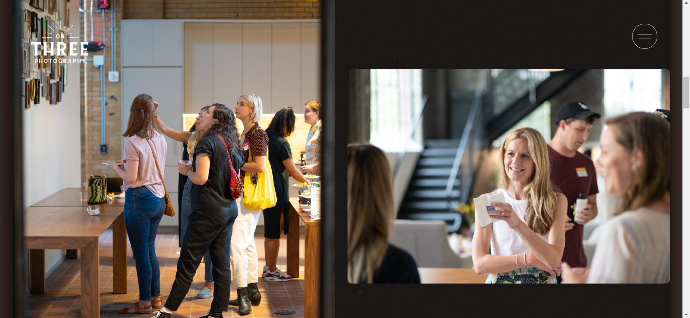
Image too large, does not fully fit within viewport. Consider normalizing image sizes and expanding them on click.
Images not aligned

Slide 11
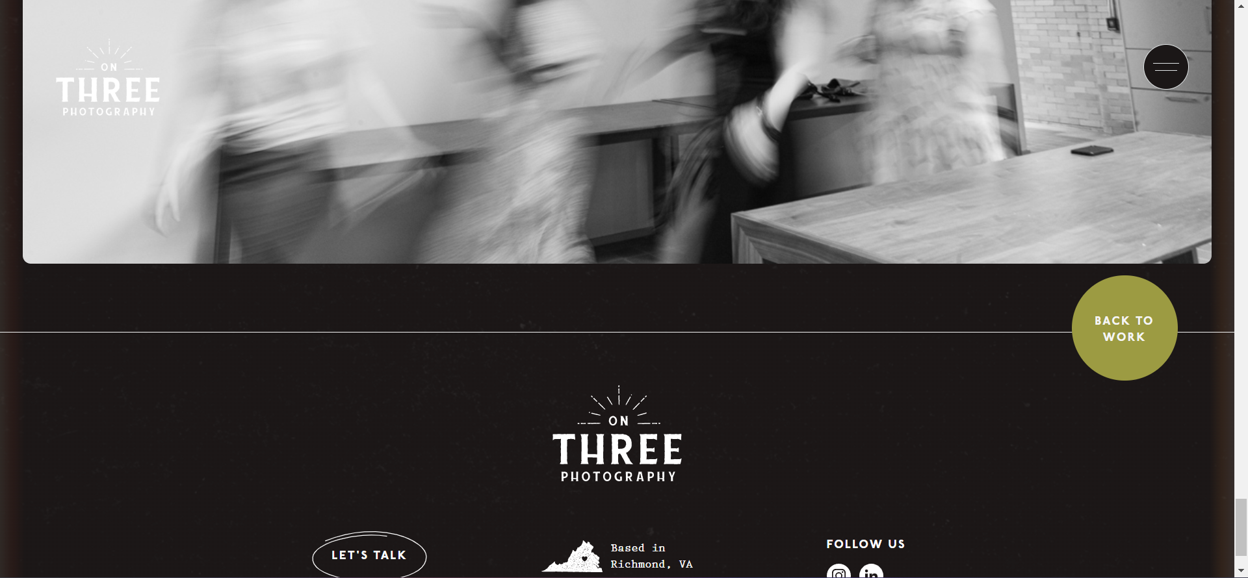
User has to scroll to bottom to go back, button should be fixed to viewport

Slide 12
About Page

Slide 13
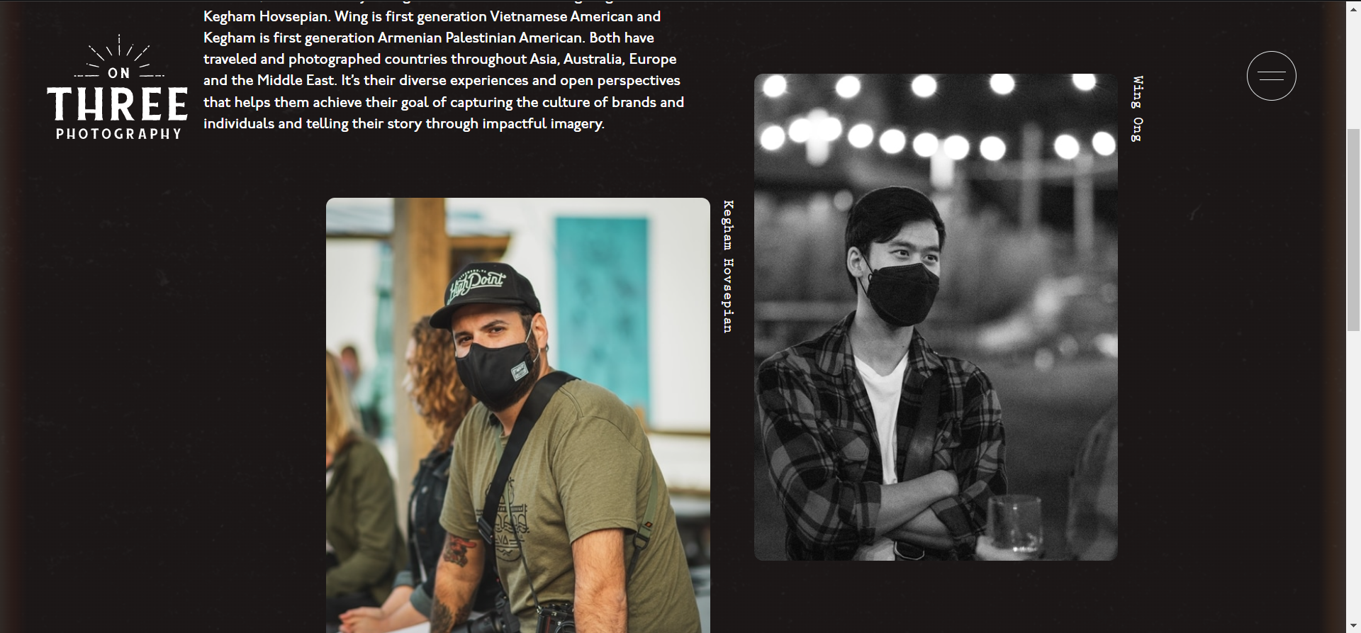
Large block of text, hard to read
Different font not needed
Text orientation hard to read
Text and images not aligned; a subjective design choice?
Both images should be in color or black and white

Slide 14
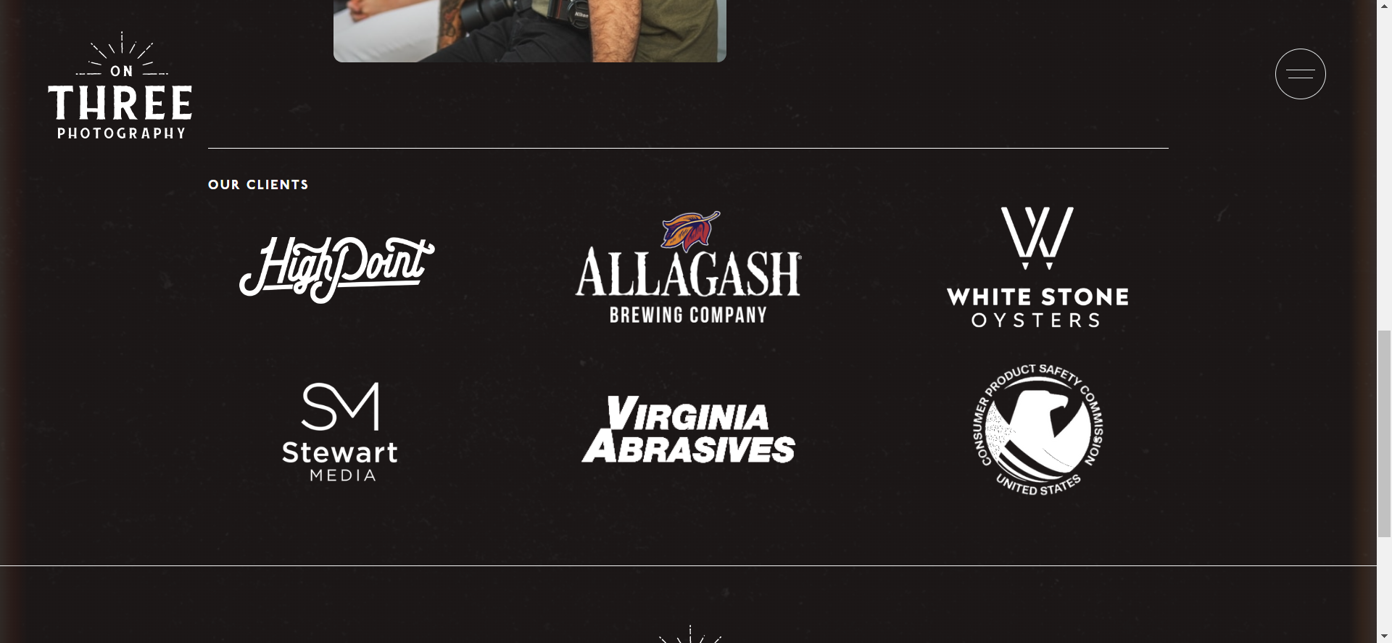
Unrelated to about page; this is already shown in the work page
Write more about journey, purpose and motivation.

Slide 15
Contact Page

Slide 16
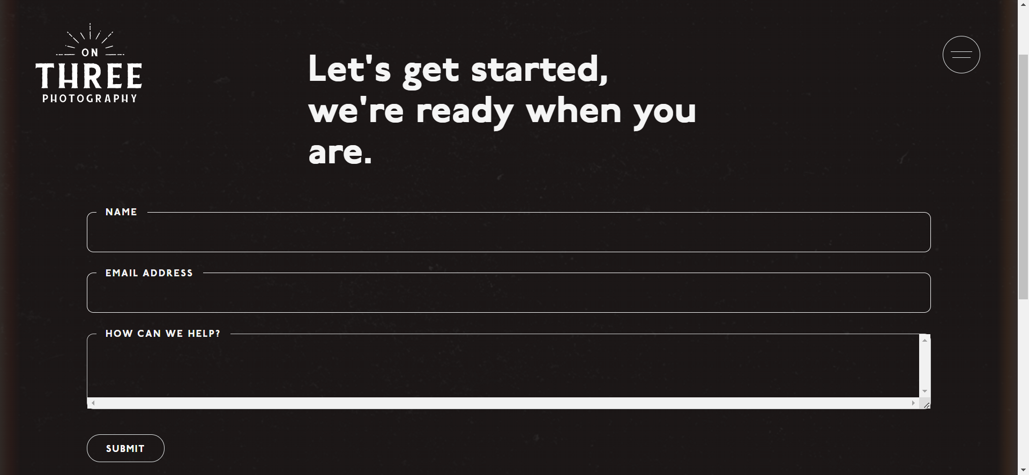
Misalignment between header and form
Form field too large - names and emails typically are not that long.
Text area should be noticeably larger than other fields
Scrollbar on text area breaks theme of website

Slide 17
Navigation Menu

Slide 18
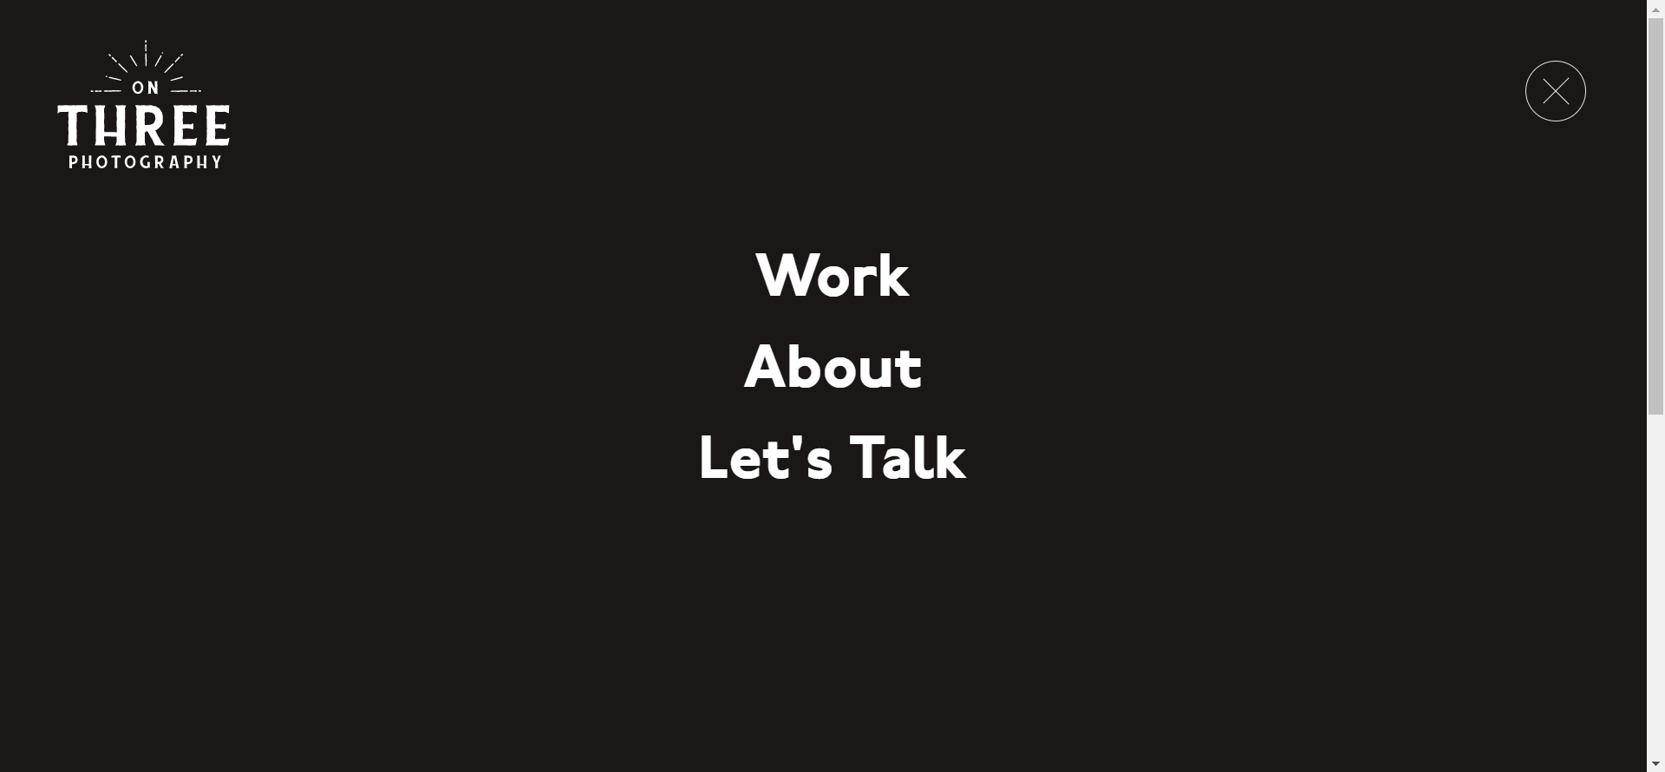
No indication of current page, link to home page is missing
Very static; lack of interactivity, hover effects, animations
Large empty black space

Slide 19
General concerns

Slide 20
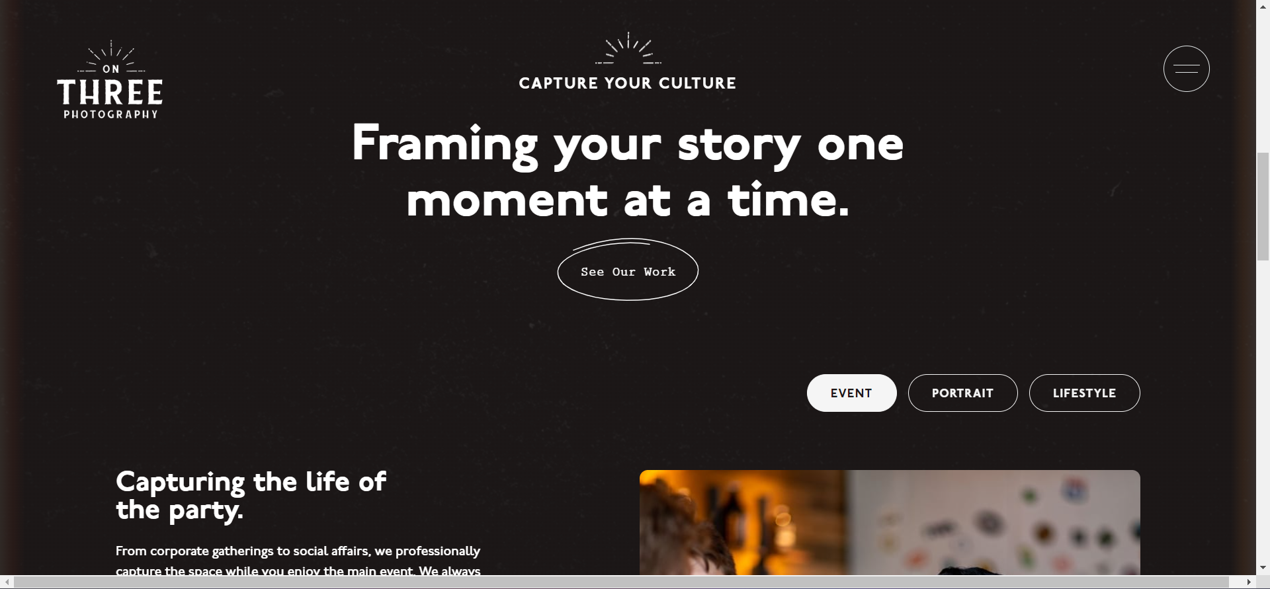
Strange placement of different font families

Slide 21

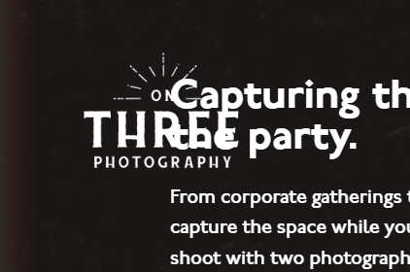
Low contrast on logo, sometimes hard to read

Slide 22
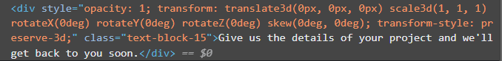
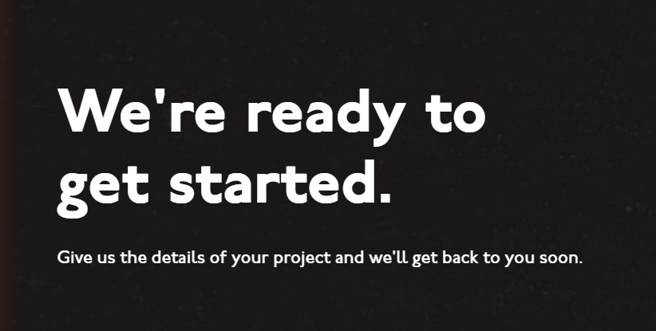
Text often found inside div element
Large skips in font-sizing, inconsistent HTML header usage

Slide 23
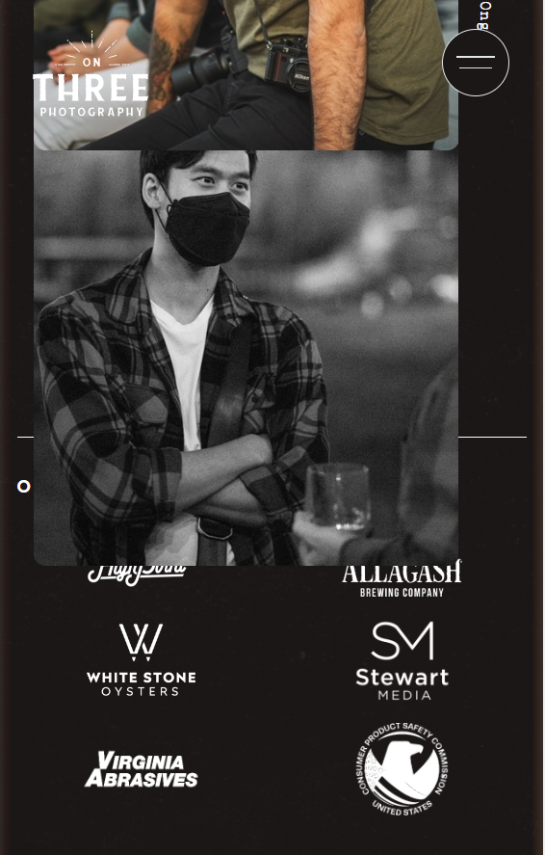
Poorly defined breakpoints for mobile view

Slide 24
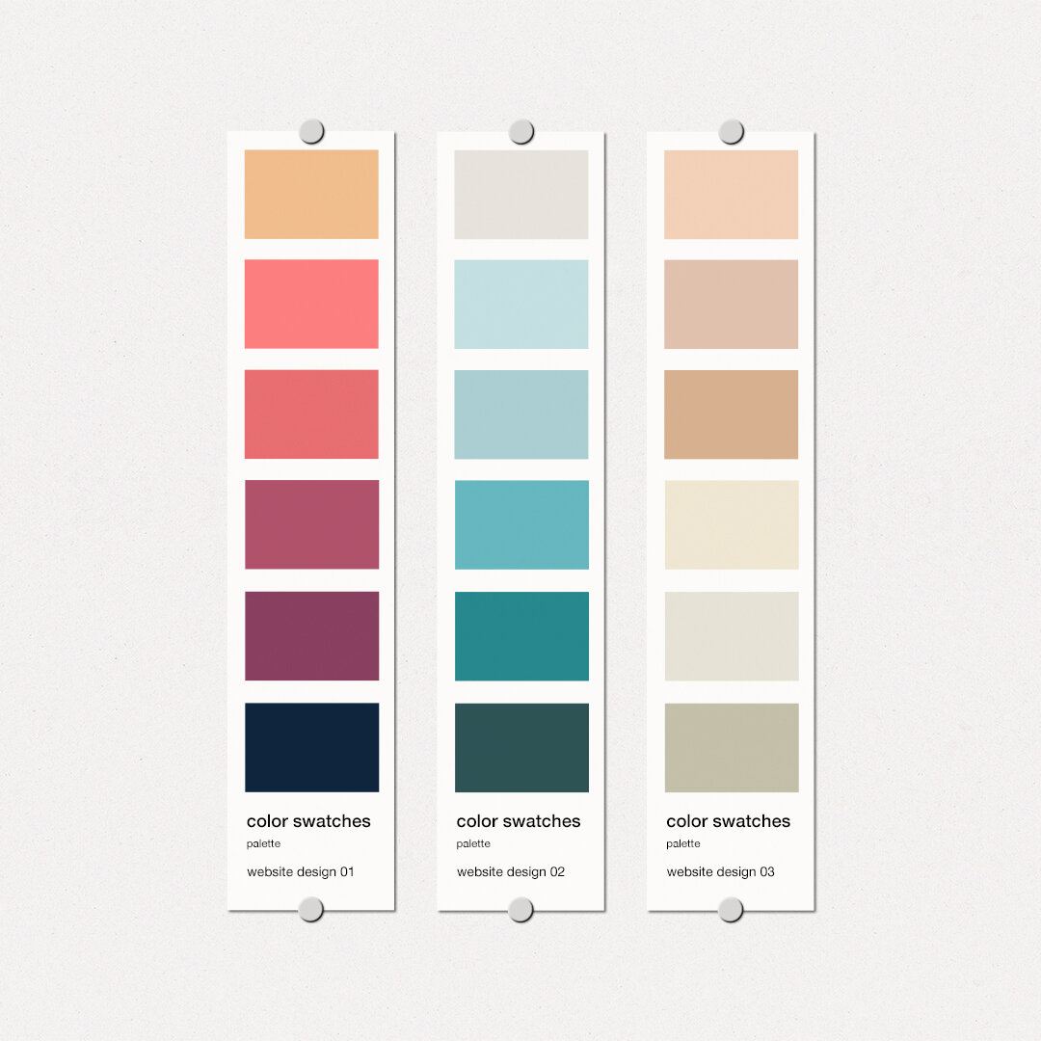
Site Perception
Fonts, colors, and aesthetic

Slide 25
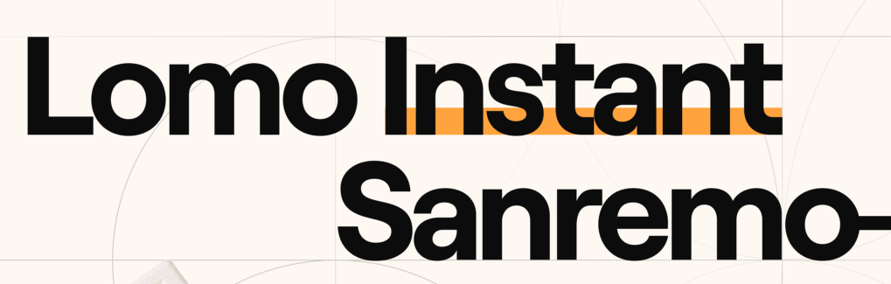

Impacts of font
Serif or sans-serif?
Serif fonts: perceived as more formal and mature - typical for newspapers and editorials.
Sans-serif: perceived as modern, bold and new - easier to read.
Geometric or organic?
Geometric: well defined angles, rigid and structured
Organic: curvy, hand-printed quality
Font-weight and sizing
Determines the flow of the website
Viewers typically read from bold to light > top to bottom

Slide 26
The current fonts
P22 Underground (Adobe)
Sans-serif, geometric
Prestige Elite (Adobe)
Serif, geometric
General concerns
Fonts do not match well together. While sans-serif and serif fonts can be mixed, underground evokes too much playfulness while prestige evokes formality.
Prestige used very sparingly and in strange settings

Slide 27
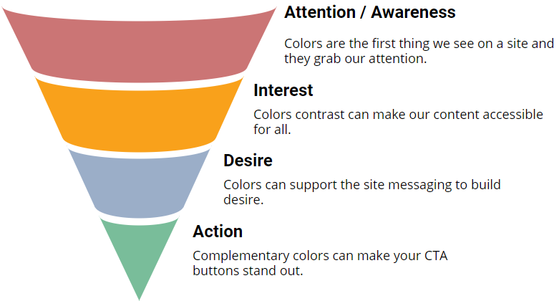
Impacts of color
Color symbolism
Influences how a visitor feels when visiting a site
Influences the personality of a site
Directing attention
Popping accent colors can influence the order in which users view the site
A good color scheme can hold interest for users to take desired action

Slide 28
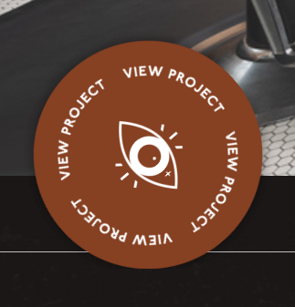
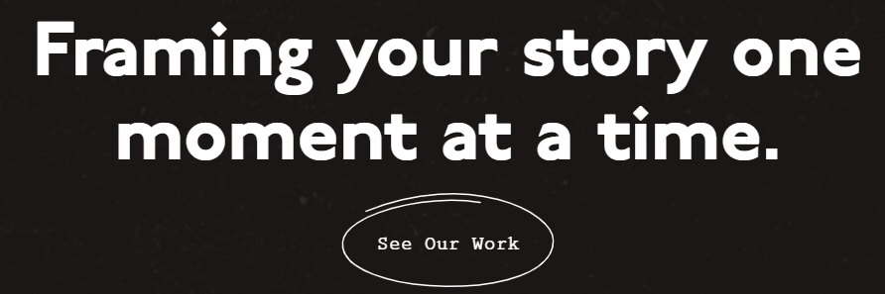
The current colors
Base: black
Secondary: white
Accent: #864022
General concerns
Accent color is only used once on the entire site
Black and white color scheme evokes sophistication, luxury and elegance, conflicts with playful font and overall organic design of site
Full black on full white provide high contrast, can be straining on eyes

Slide 29
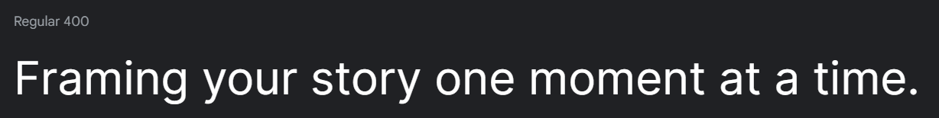
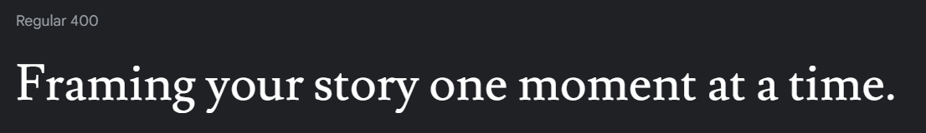
New fonts
Inter, sans-serif
To be used for main content
Sleeker and more geometric, easier to read
Feels more modern
Lusitana
To be used for a flashy heading
A good transition between logo font and main site

Slide 30
New colors
Base: #fdfcf5
Secondary: #201f1e
Accent: #0b6fc1
Black and white colors slightly muted for lower contrast
White on black -> black on white for more professional aesthetic
Accent color swapped for a safer, more agreeable medium blue

Slide 31

Prototyping
A preview of the redesign

Slide 32
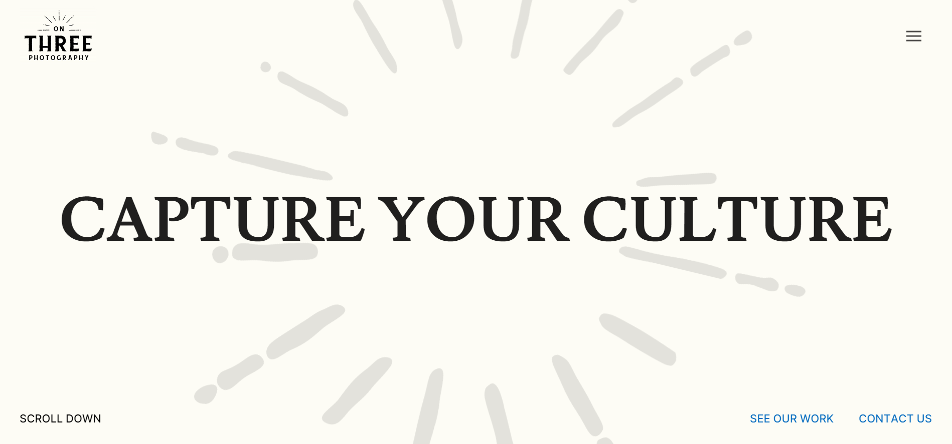
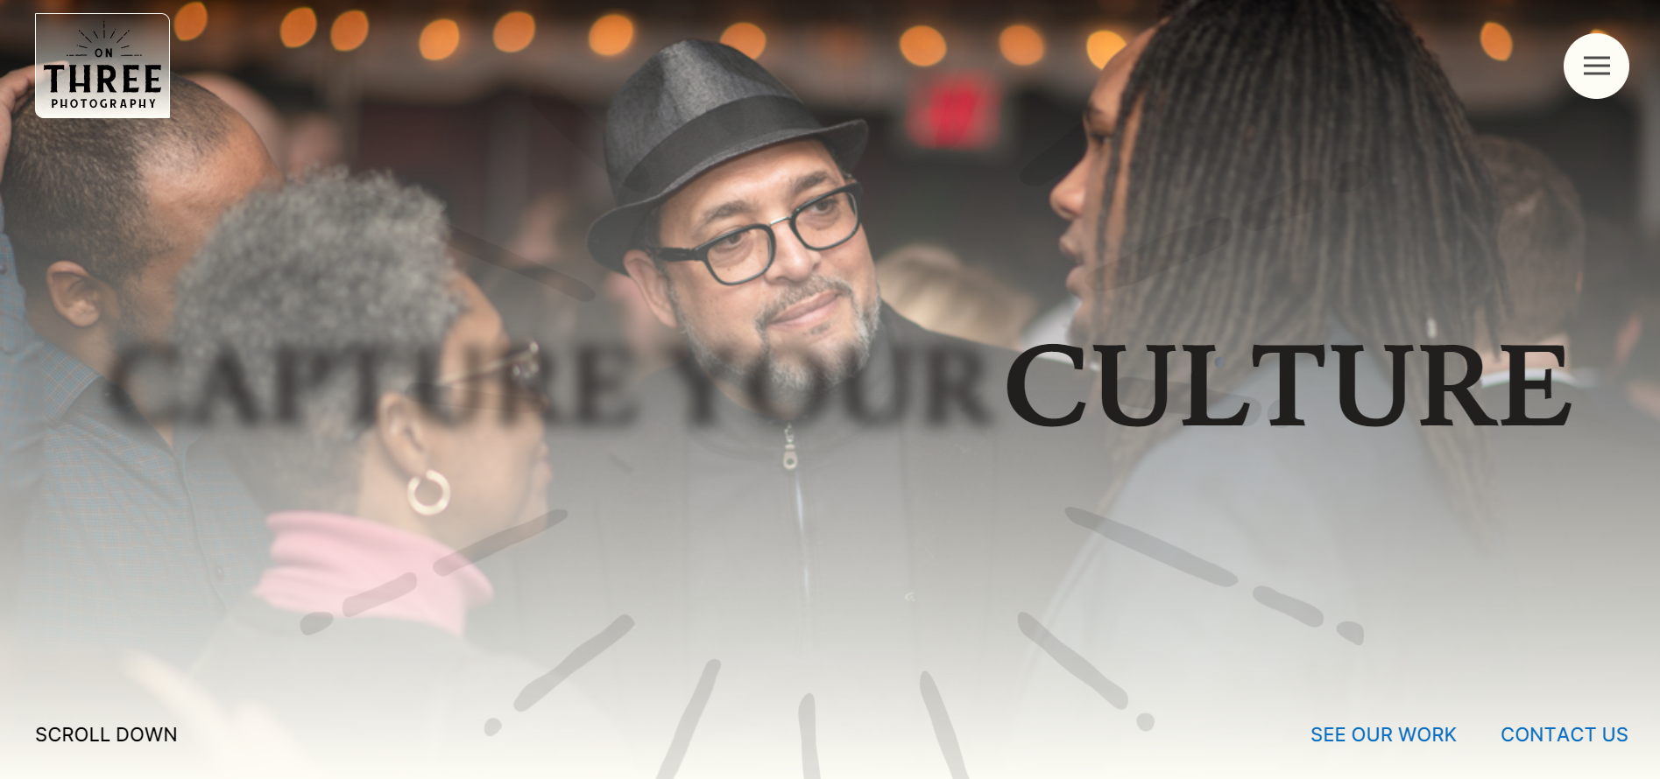
Hero Section
Added tag-line as header
Mouse hover interaction
Logo contrast
Scrolling incentive
Call to action highlighted with accent color

Slide 33
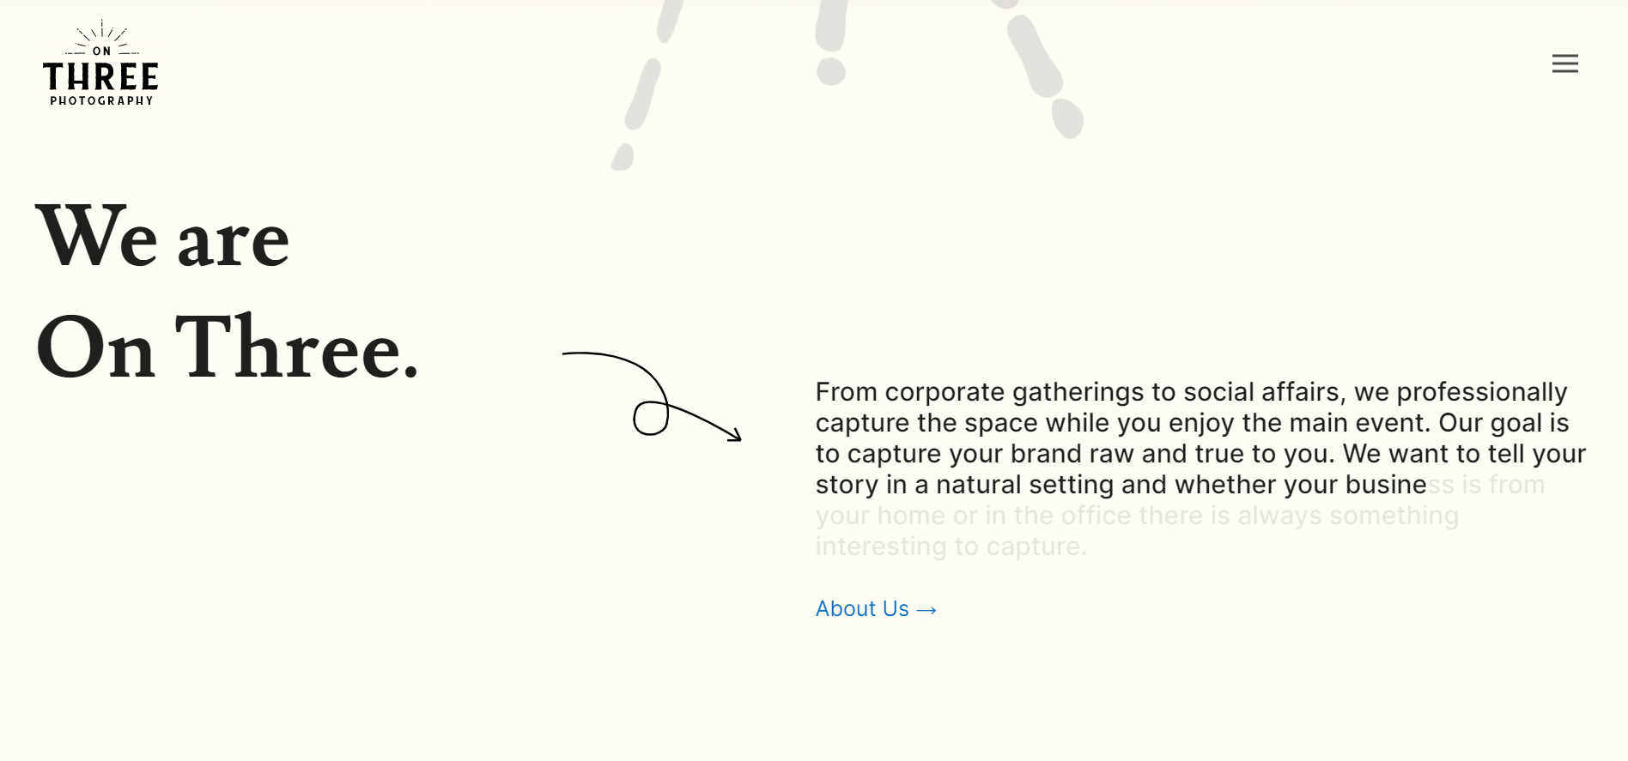
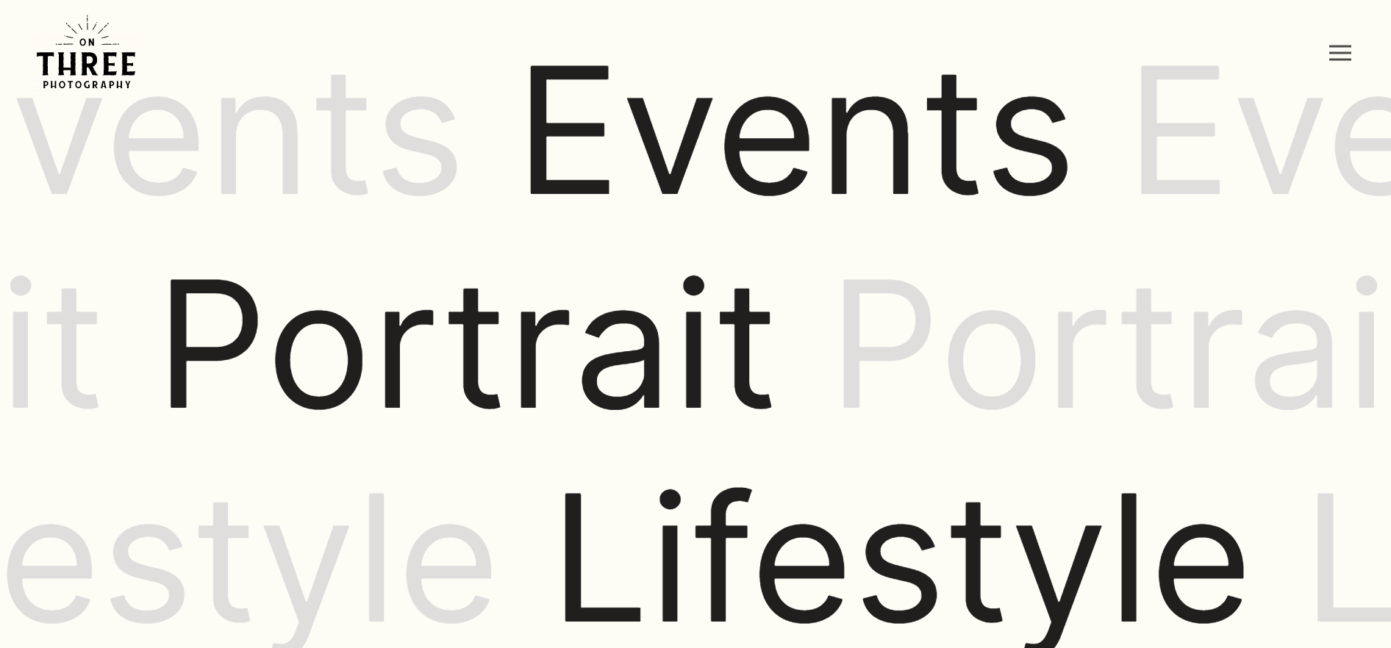
Home Page
General description of business directly under hero
Two fonts contrast headers with general text
Additional CTAs accented with color
Scroll triggered animation, gives viewer incentive to continue reading

Slide 34
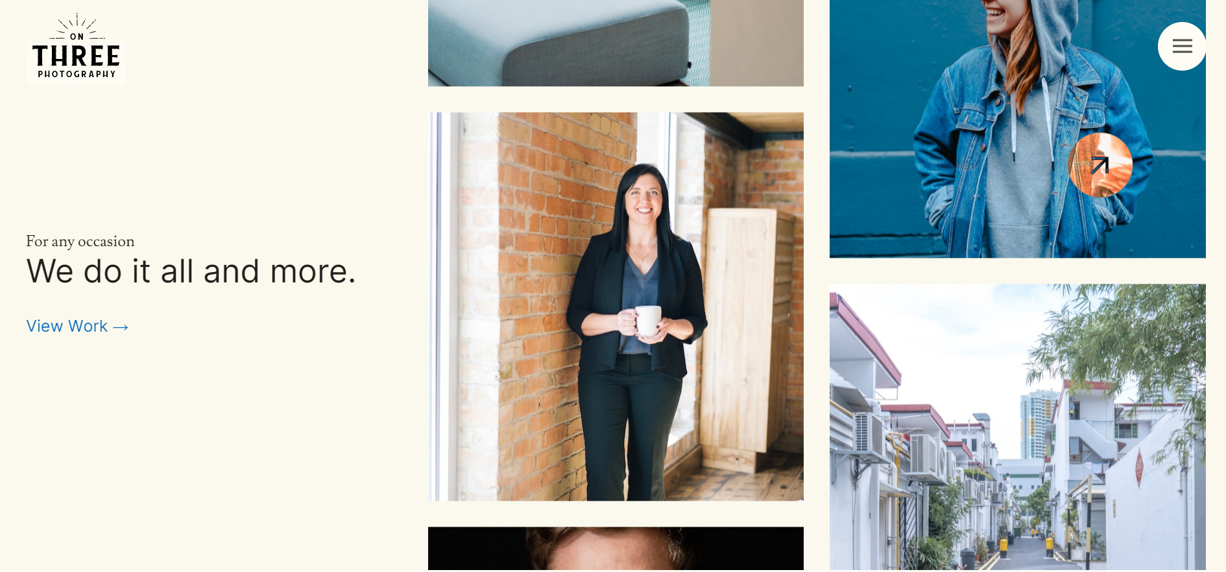
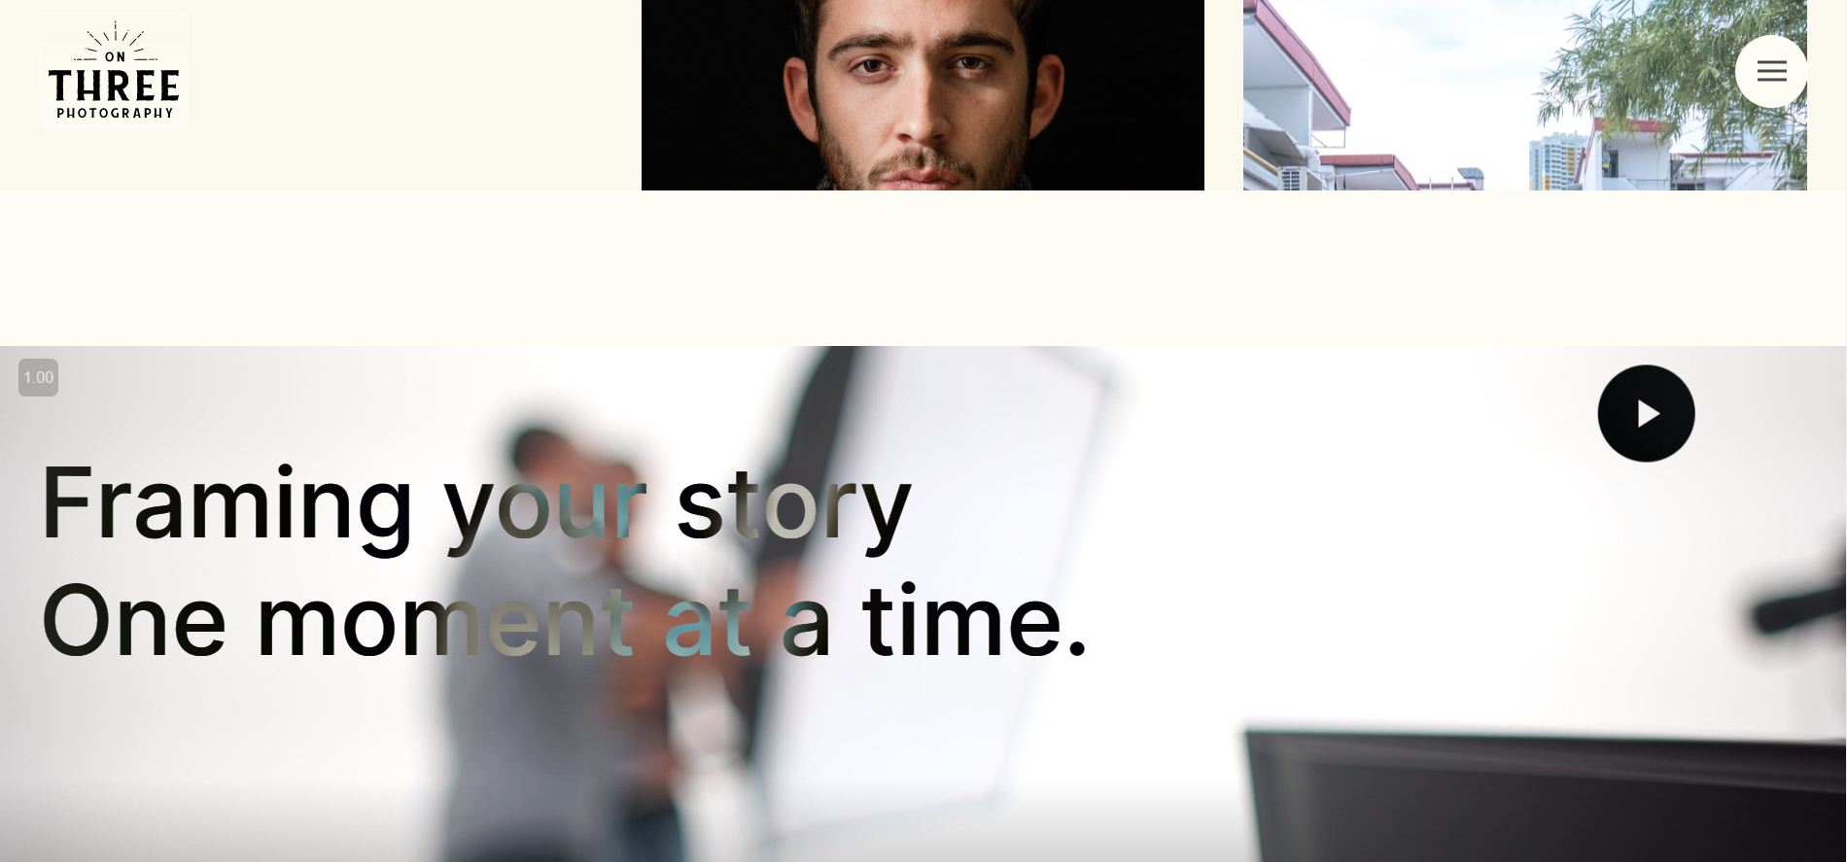
Home Page cont.
Smart mouse trailer expands to reveal different interactions
Moving gallery to showcase work
Introductory video

Slide 35
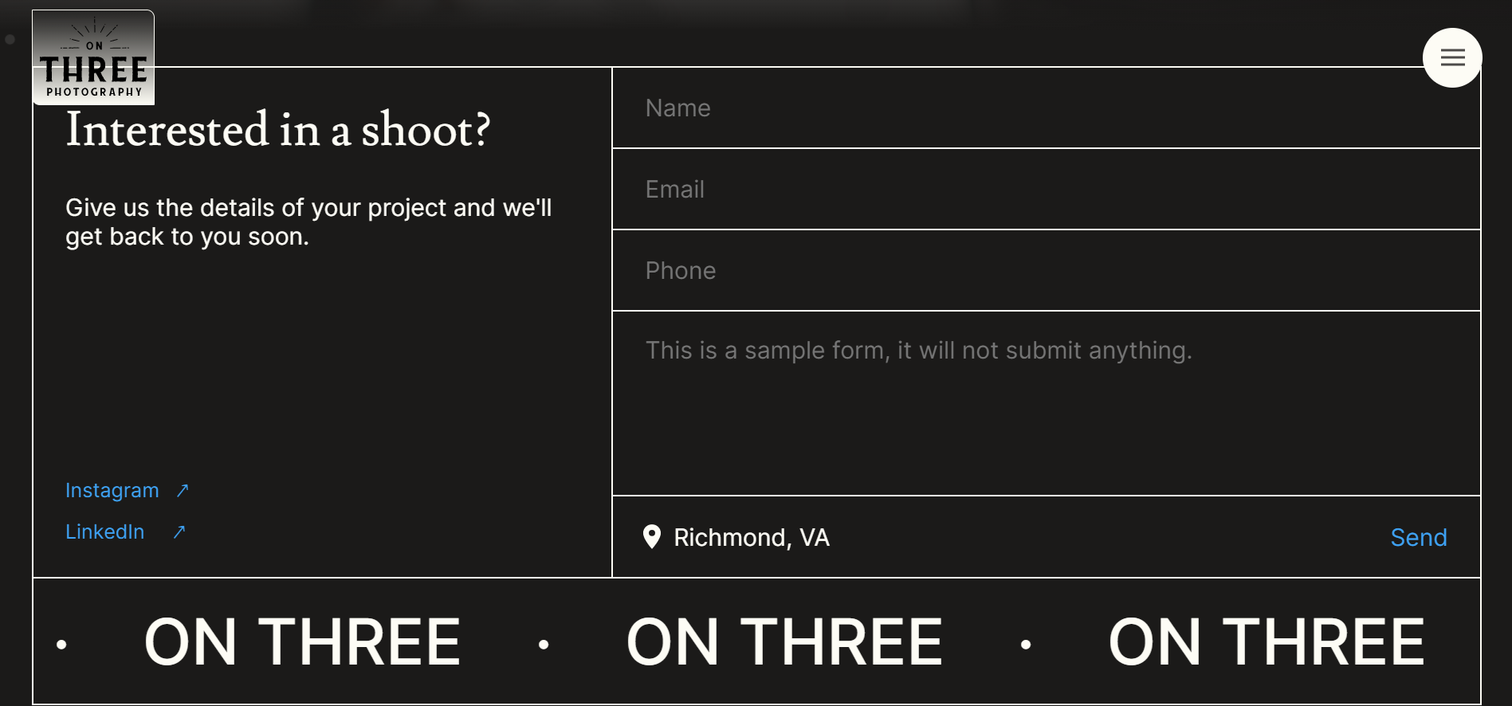
Home Page Footer
Simple, sleek and intuitive form field - scrollbar hidden
Social links accented
Slow scrolling infinite marquee adds visual appeal and branding

Slide 36
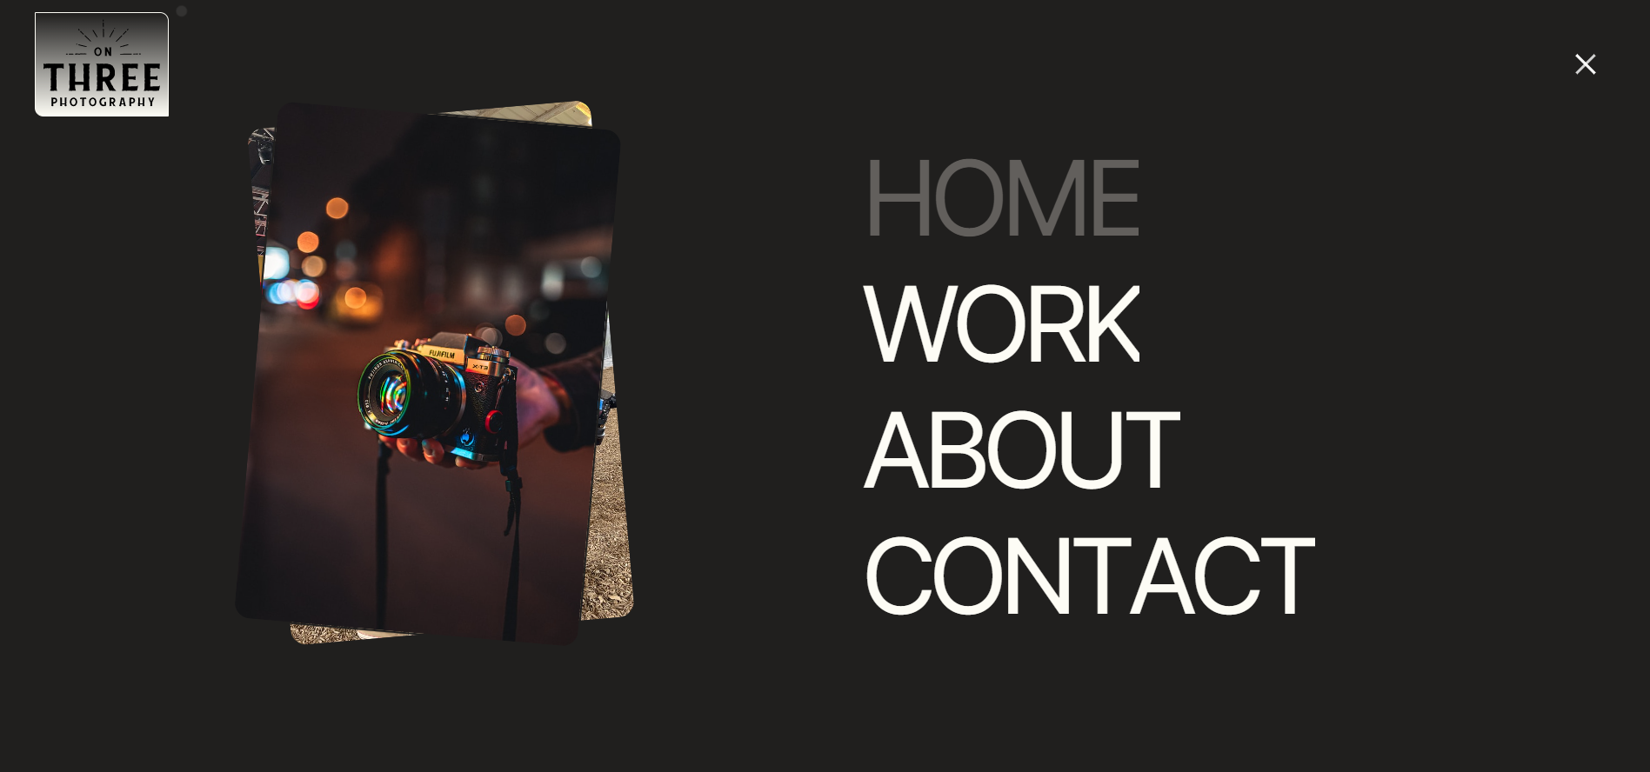
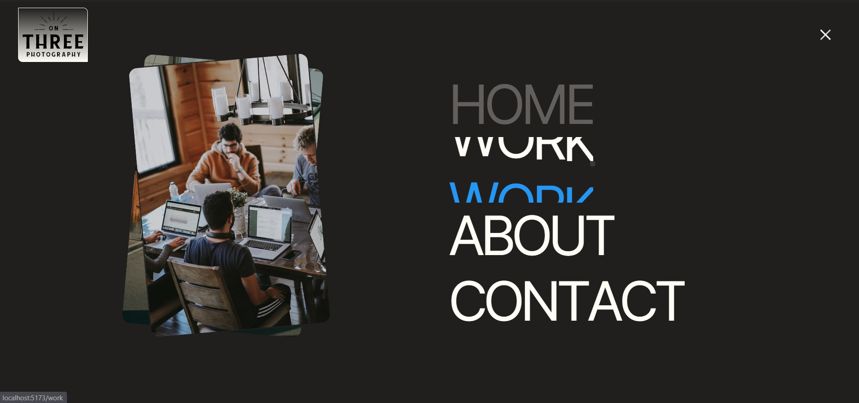
Nav Menu
Images added to fill in empty space
Home and current page indicator added
Text scrolling animation on hover
Mouse interactions swap images on link hover

Slide 37
Links
Working home page prototype (responsive)
https://onthreeprototype.netlify.app/
Github repository
https://github.com/briannuggets/OnThreePrototype

